Slide 1
Individualized math practice, simplified.

Slide 2
Agenda
Intro to Formative Loop
Getting Started & Demo
Best Practices

Slide 3
Your students complete a 5-minute
Individualized paper-pencil practice
You grade on the computer, then print tomorrow’s exercises
Notes:
It’s a simple program – your students commit to a daily 5 minute paper math exercise
It’s individualized to each student based on exactly their need
It has their NAME on it
You grade it on the computer and then print out the next days exercises

Slide 4
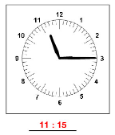
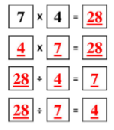
Higher level problem solving requires a solid foundation
Formative Loop is focused on basic facts & foundational skills aligned with common core and state standards
Making 10, Place Value, Expanded Form, Rounding, Number spelling
Perimeter, Fractions, Time, Money, Order of operations
Students receive daily skills practice
Practice is KEY to mastering any skill
Teachers receive daily data on student skill gaps
This is KEY to focusing instructional time

Slide 5
How it works
Students do a daily 5 minute individualized math practice on paper
Students must master a skill to advance in the program
Teachers & Administrators track progress on the Formative Loop Website
Daily practice is printed as a PDF with the student’s name on it
Easy to adopt consistently across a campus
5 mins in class for the practice & 4-7 mins for grading and feedback
Fine-grained reports for teachers and administrators to identify problem areas and needed intervention
Individualized Homework included for extra practice and parent involvement
Points and Award Certificates keep the students engaged

Slide 6
Getting ready
1. Upload your class lists with these buttons when you first login
Possible to bulk upload students from Excel or just type in your student names
2. Add teachers or graders
They will receive a welcome email to setup their account
3. Print your first day’s exercises
When to begin the program
Grade 1 typically starts third month of school
Grades 2-8 start as close as possible to the first day of school
All students start at the beginning of the sequence – a spiral review of the previous grade level is included and students quickly get to their skill level

Slide 7
Day to day with Formative Loop

Slide 8
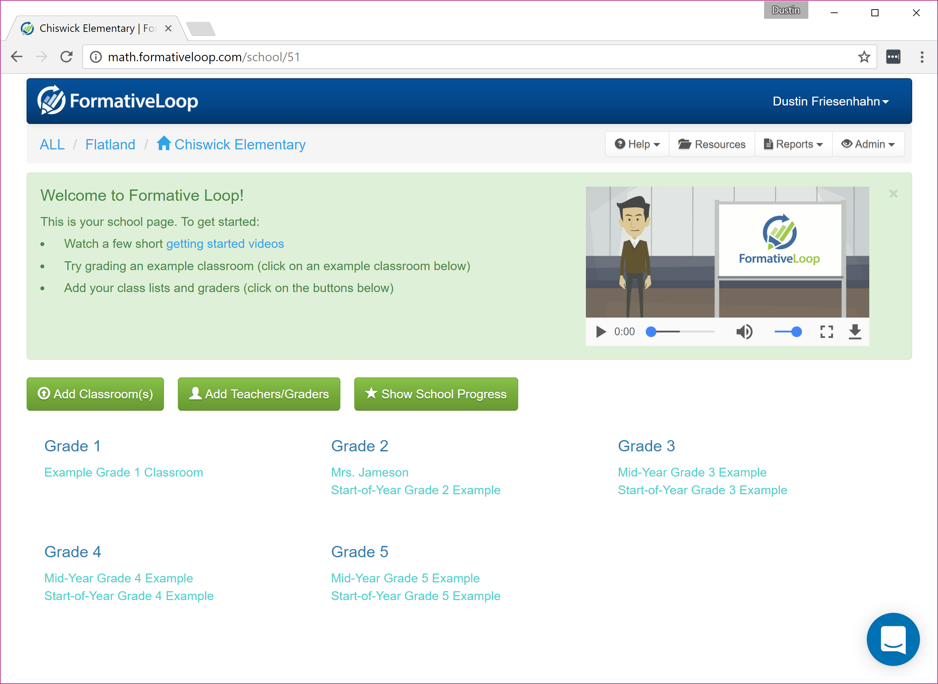
Start your math day with the 5-minute timed practice.
Collect the papers, and login to formativeloop.com with you school email.
Find your class in the list to begin grading

Slide 9
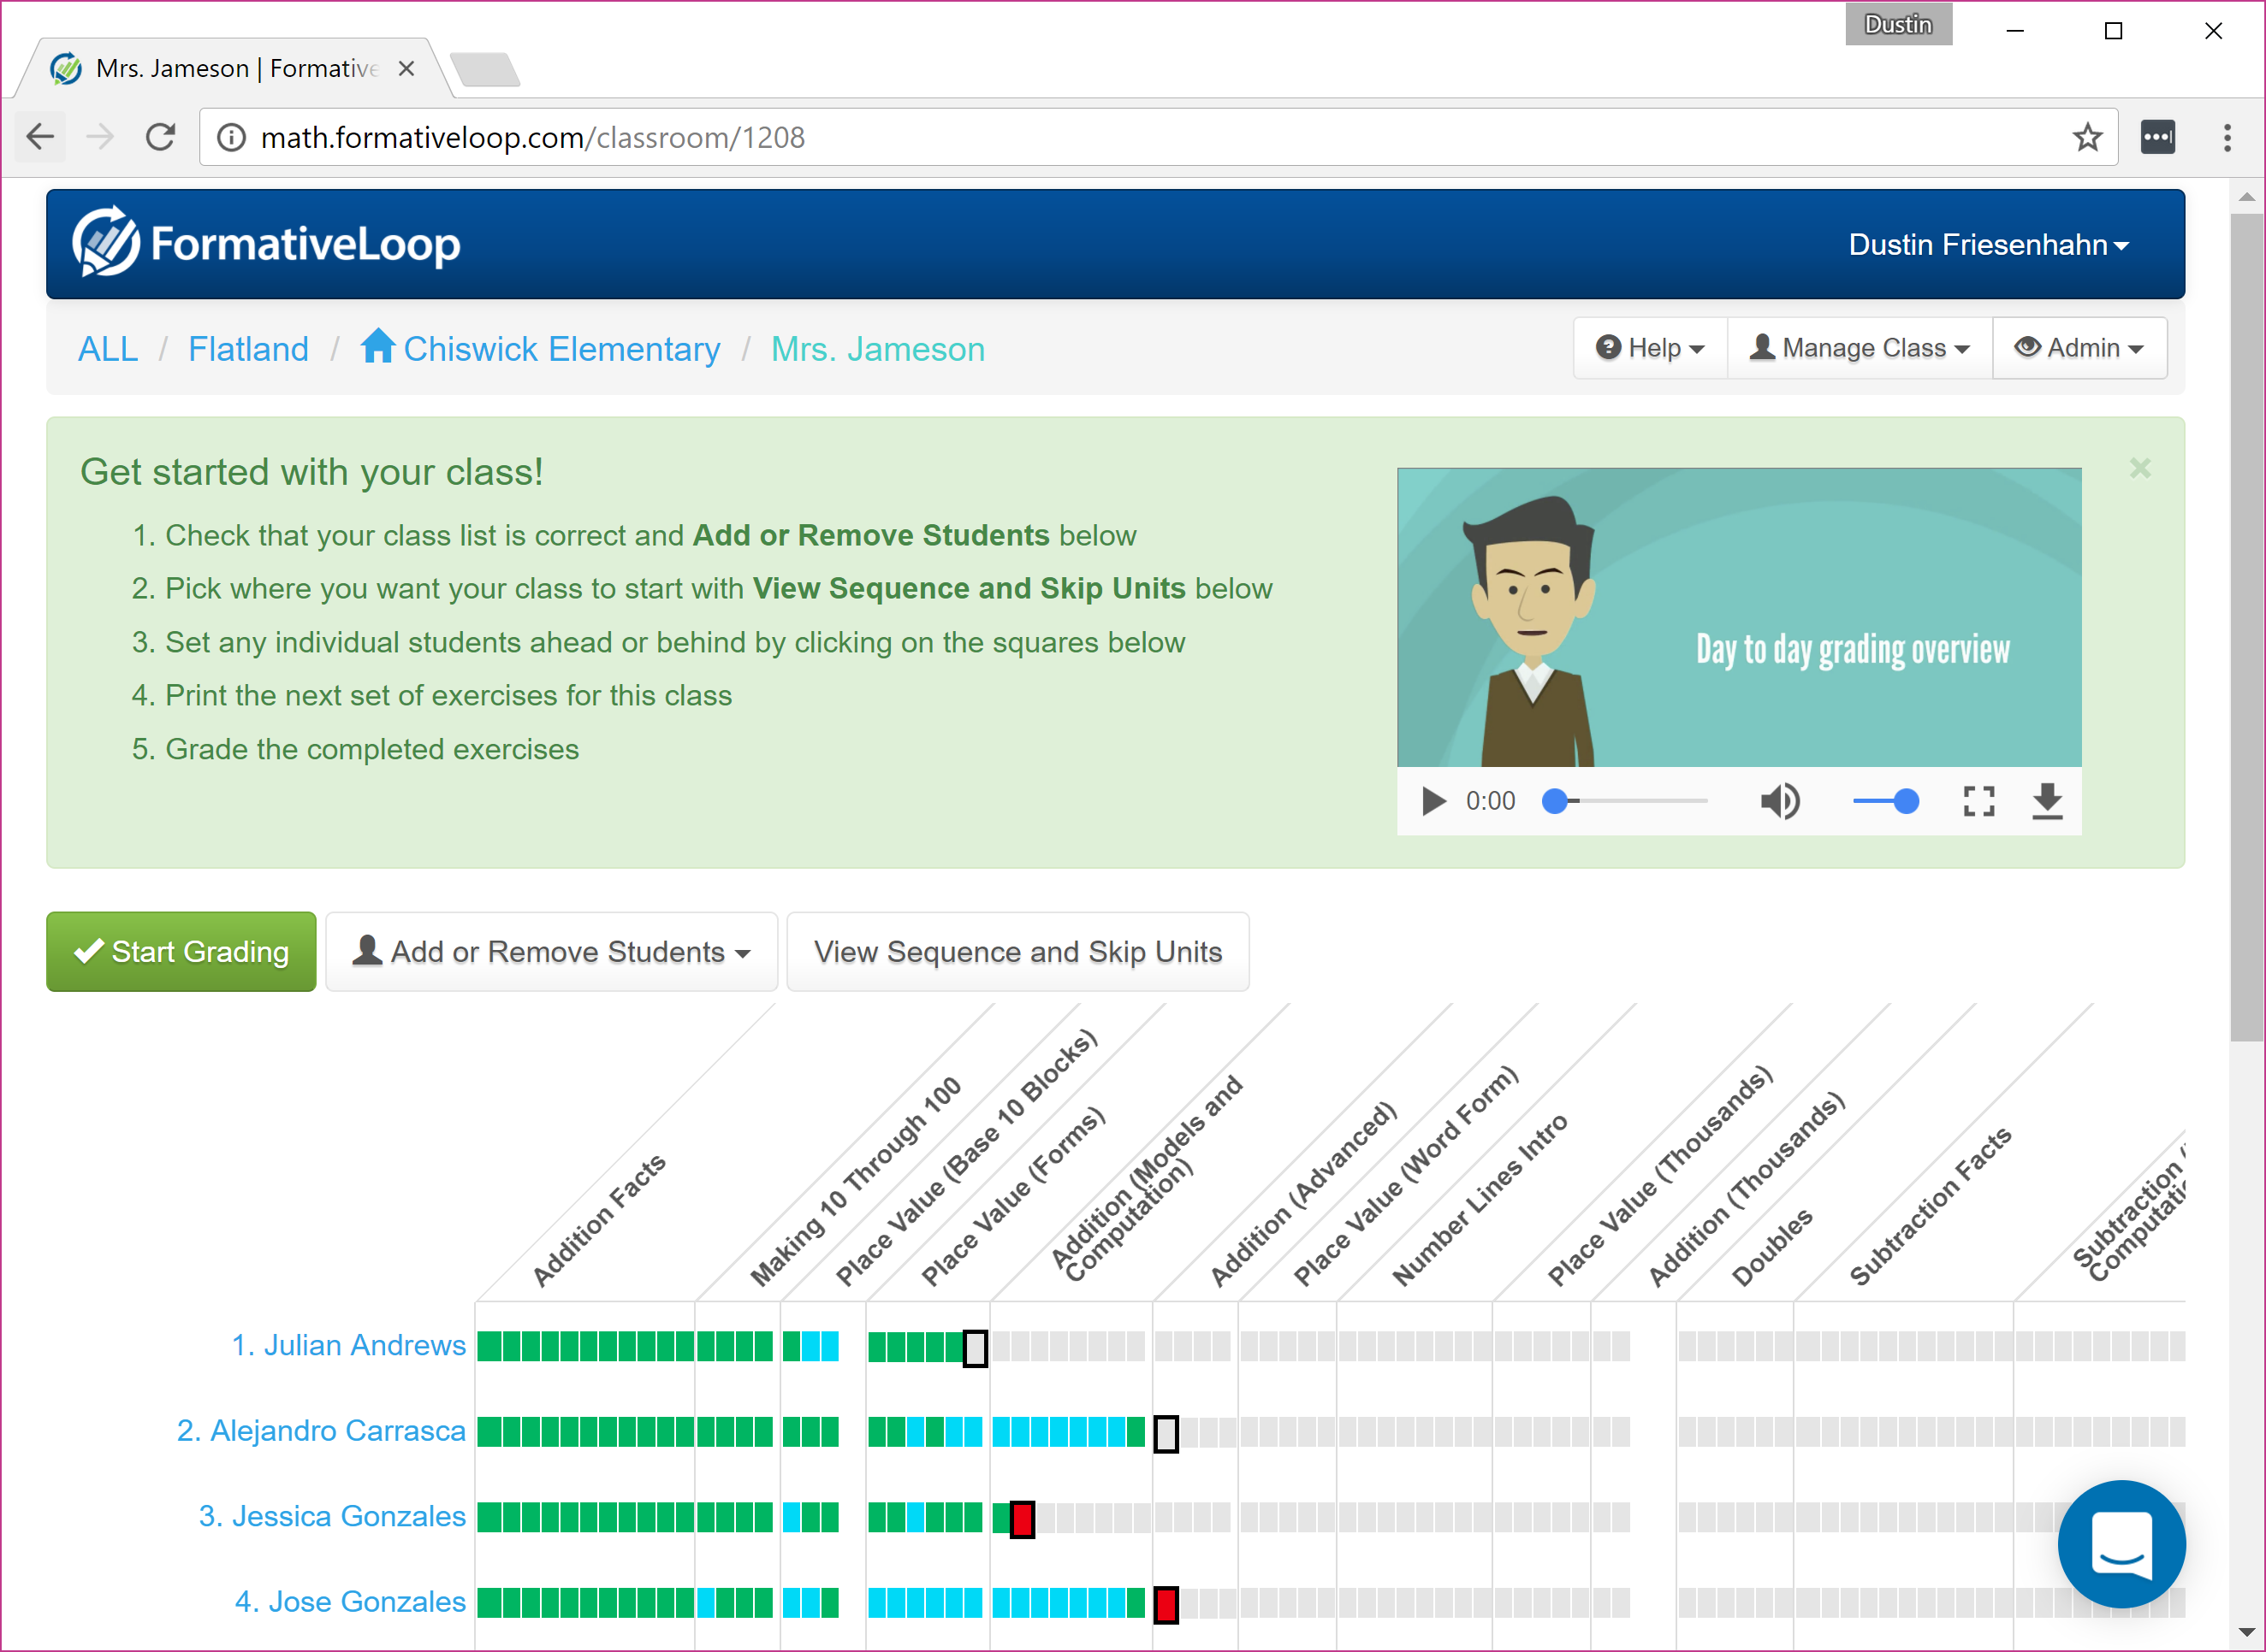
Click “Start Grading”

Slide 10
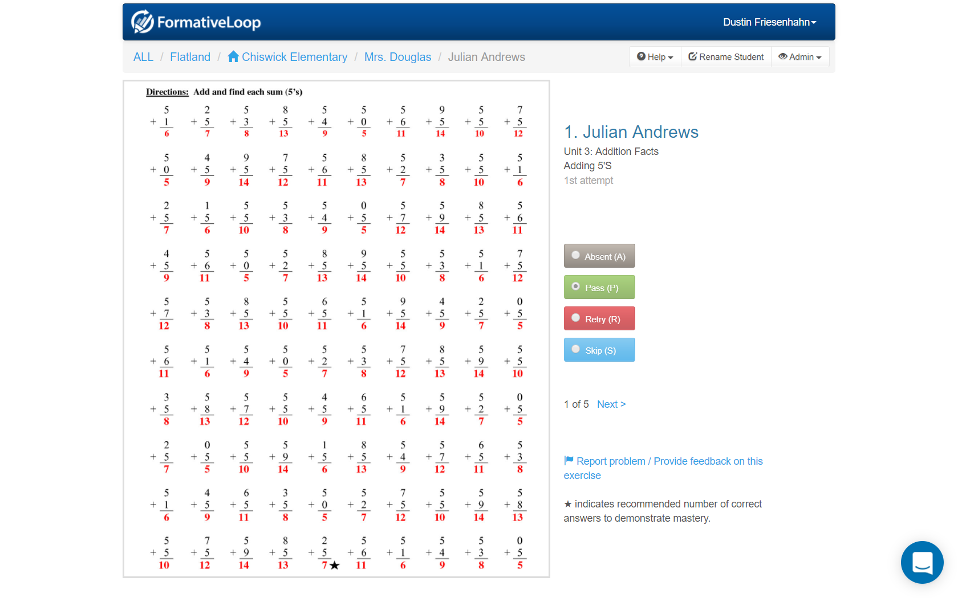
Order the papers with the numbers at the top.
The answer key is on the screen for each student.

Slide 11
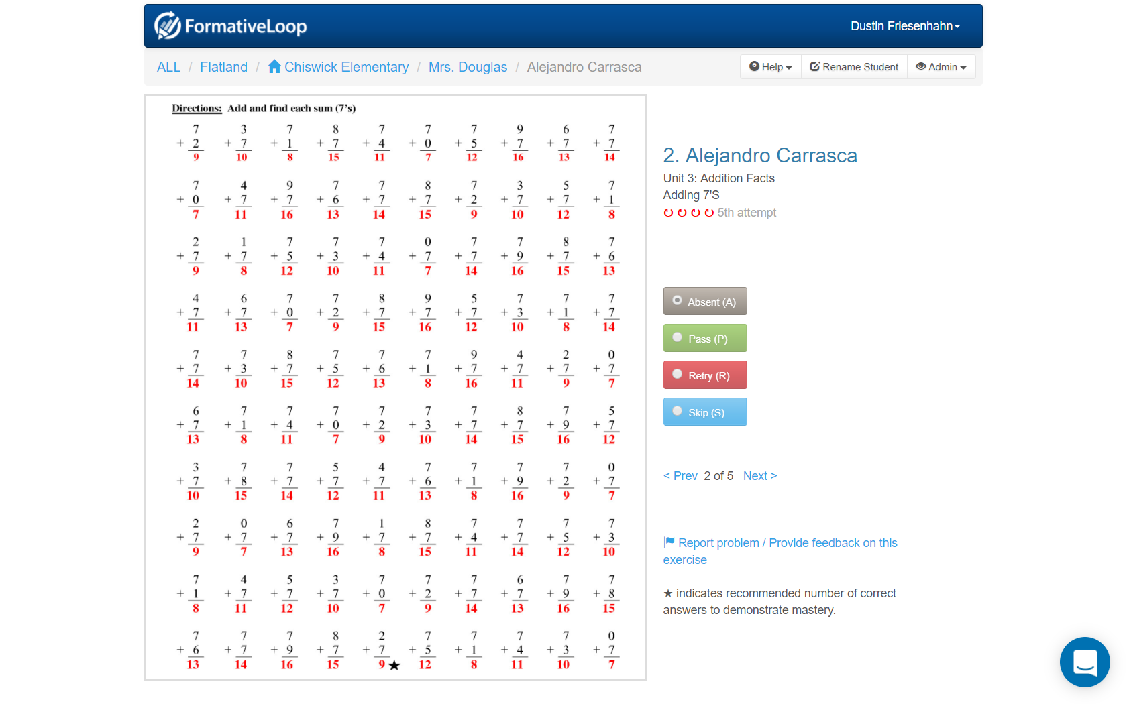
Choose Absent - Pass – Retry - Skip

Slide 12
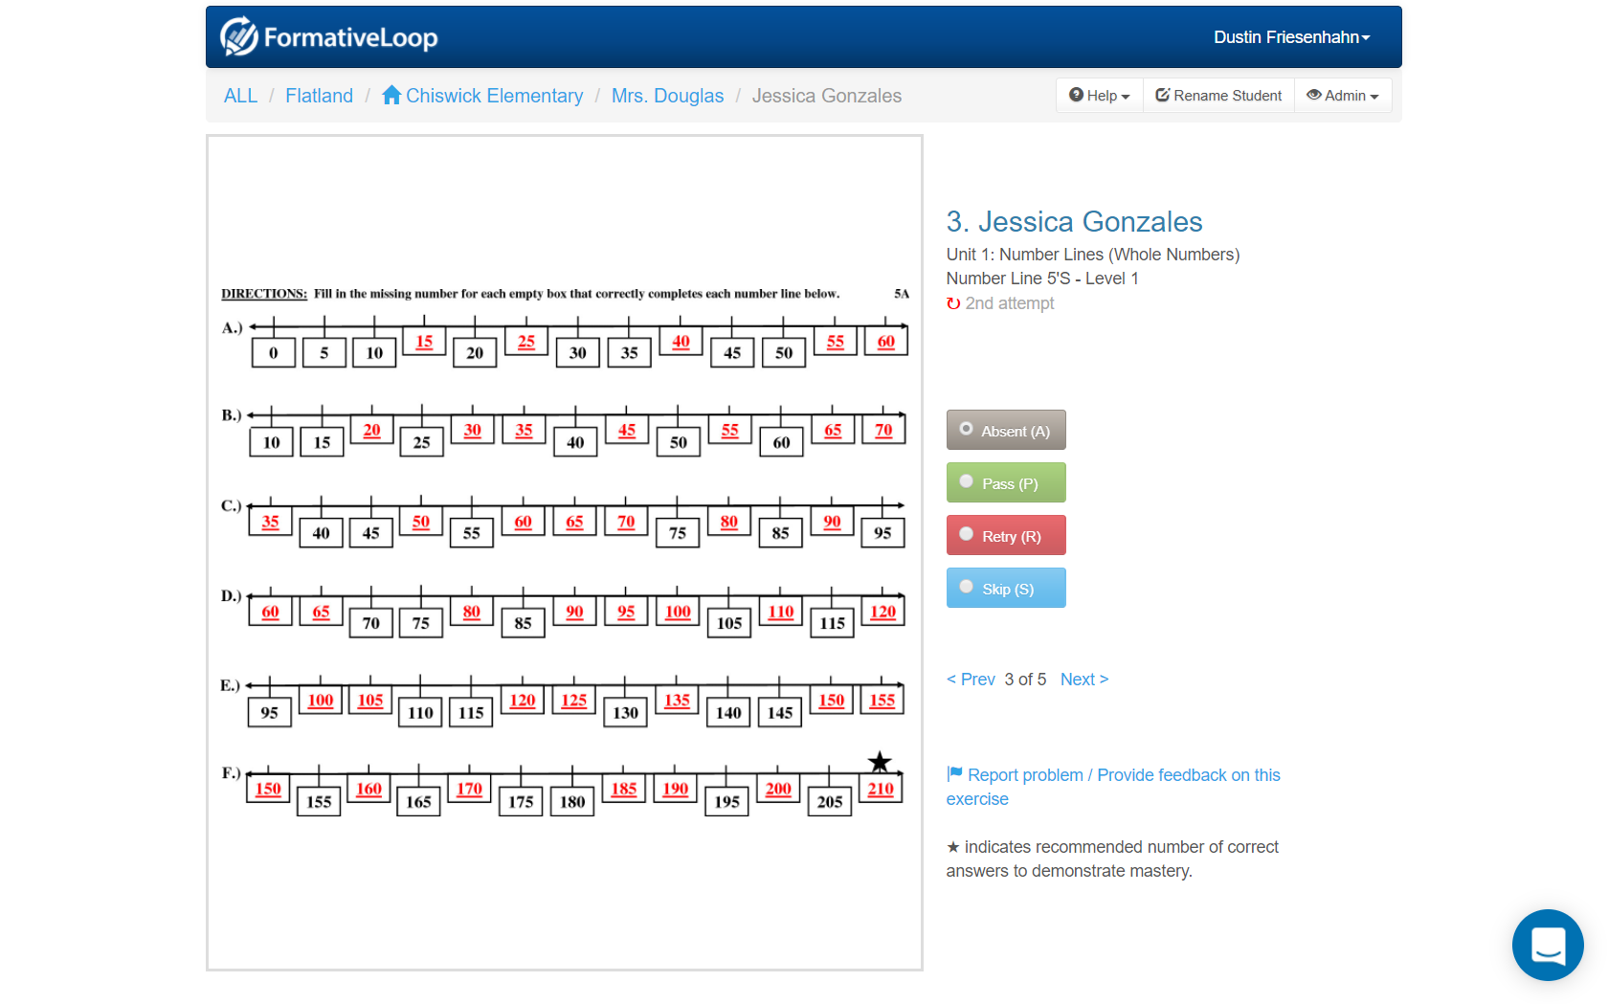
The next student’s answer key is automatically displayed

Slide 13
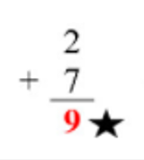
Grading Tips
Look for completion / spot check for accuracy – don’t check all problems
Use SKIP when students are stuck and you want to just move them forward with other intervention
Answer key Star indicates recommended mastery level

Slide 14
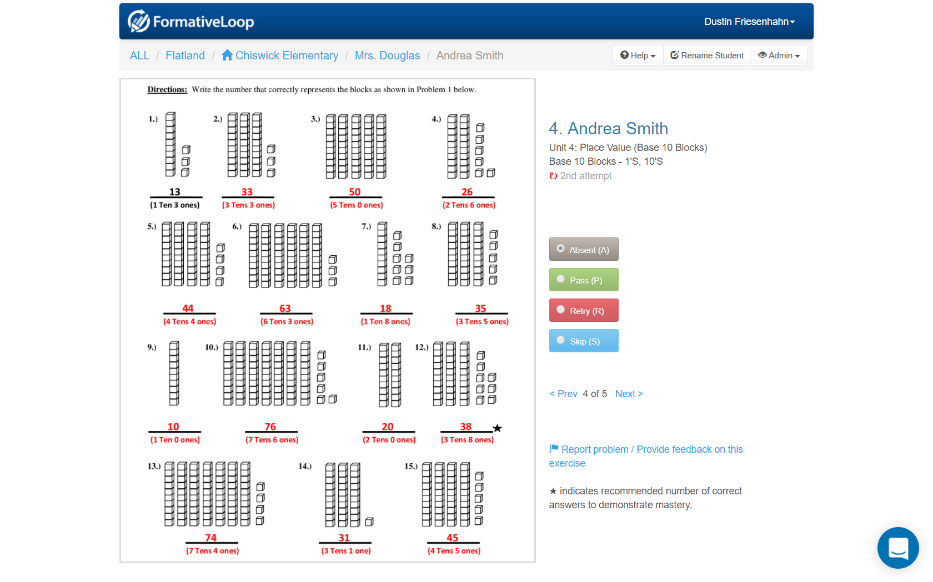
Keep going through your whole class

Slide 15
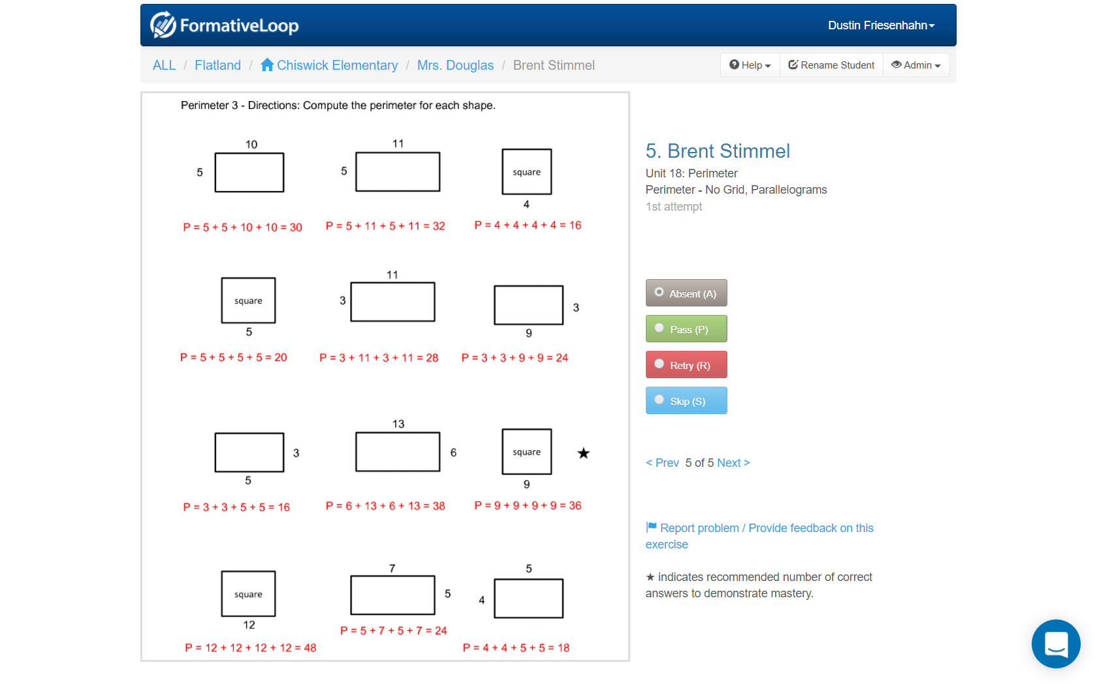

Slide 16
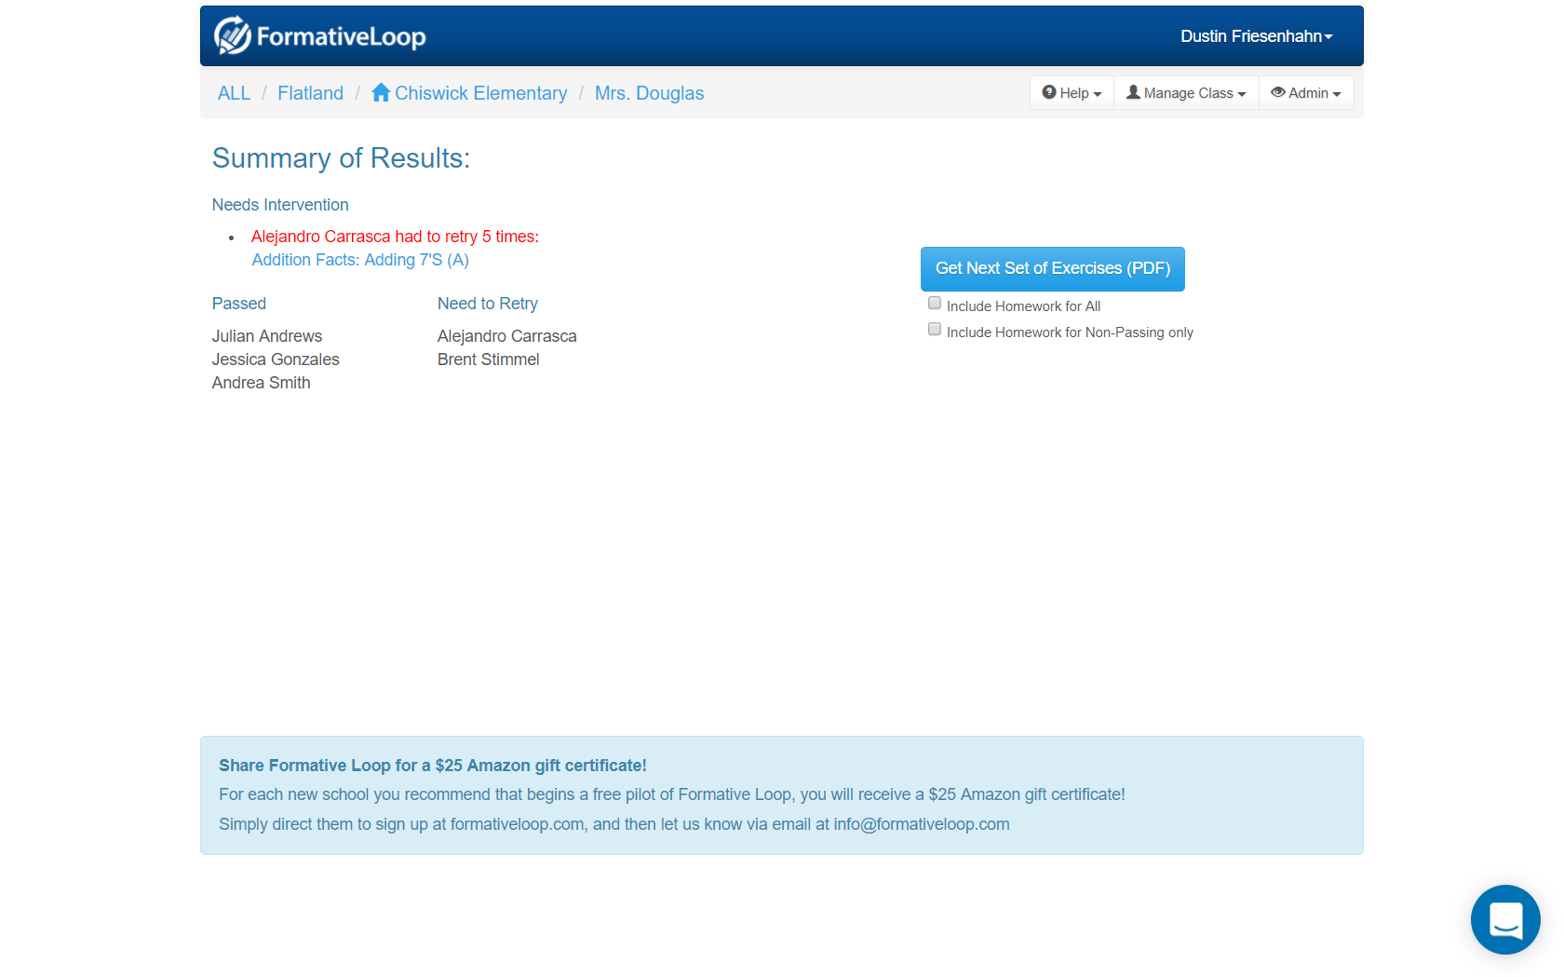
When done, students who are stuck and need extra help are highlighted in RED
Homework can optionally be included
Click “Get Next Set of Exercises” to download the PDF

Slide 17
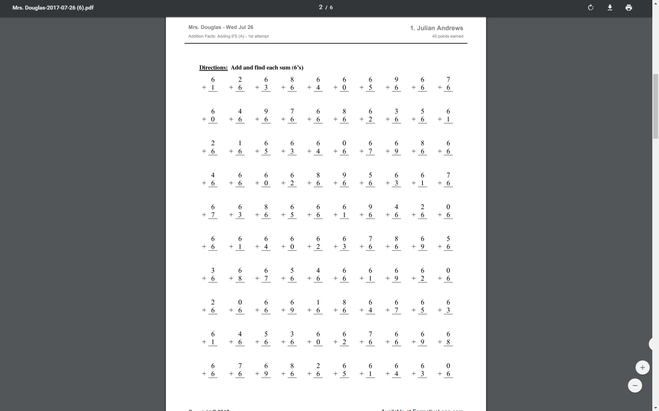
Print the next day’s exercises with this PDF

Slide 18
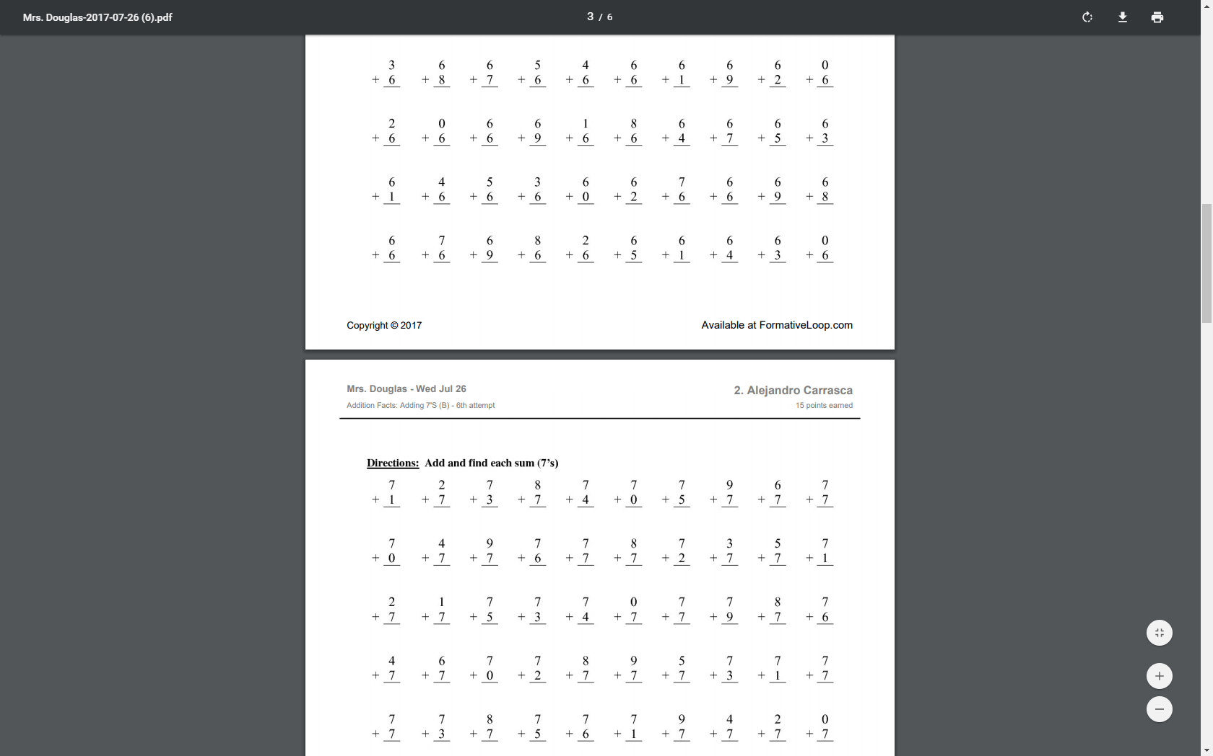
Each page will have the student’s name on it

Slide 19
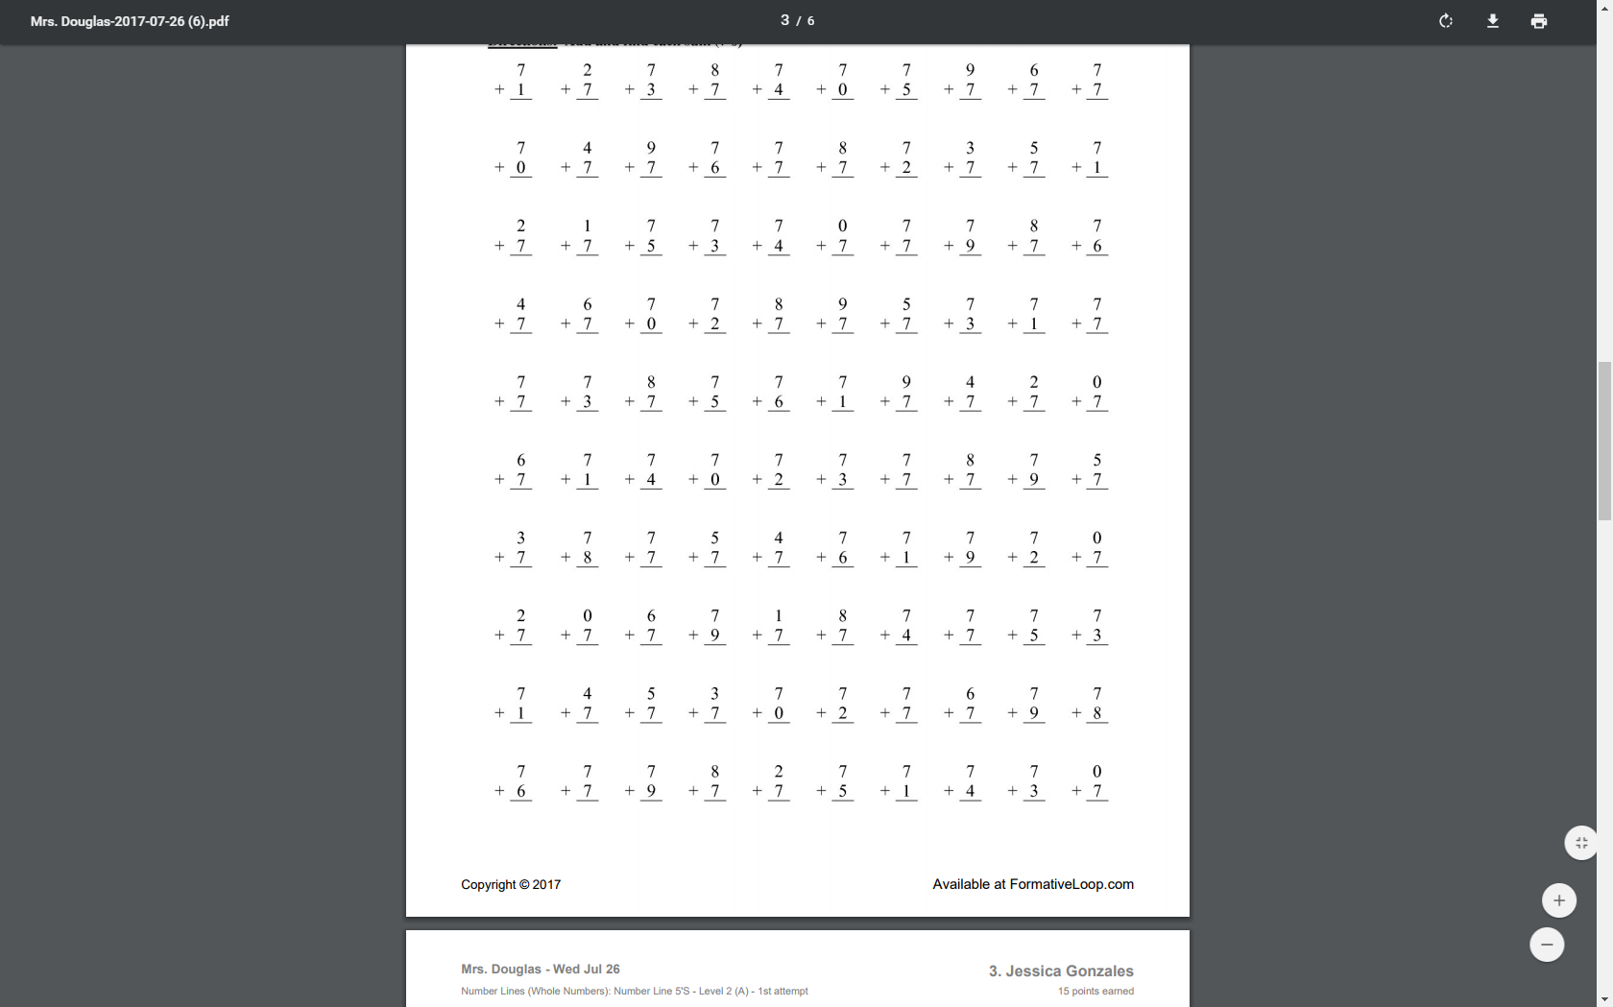

Slide 20
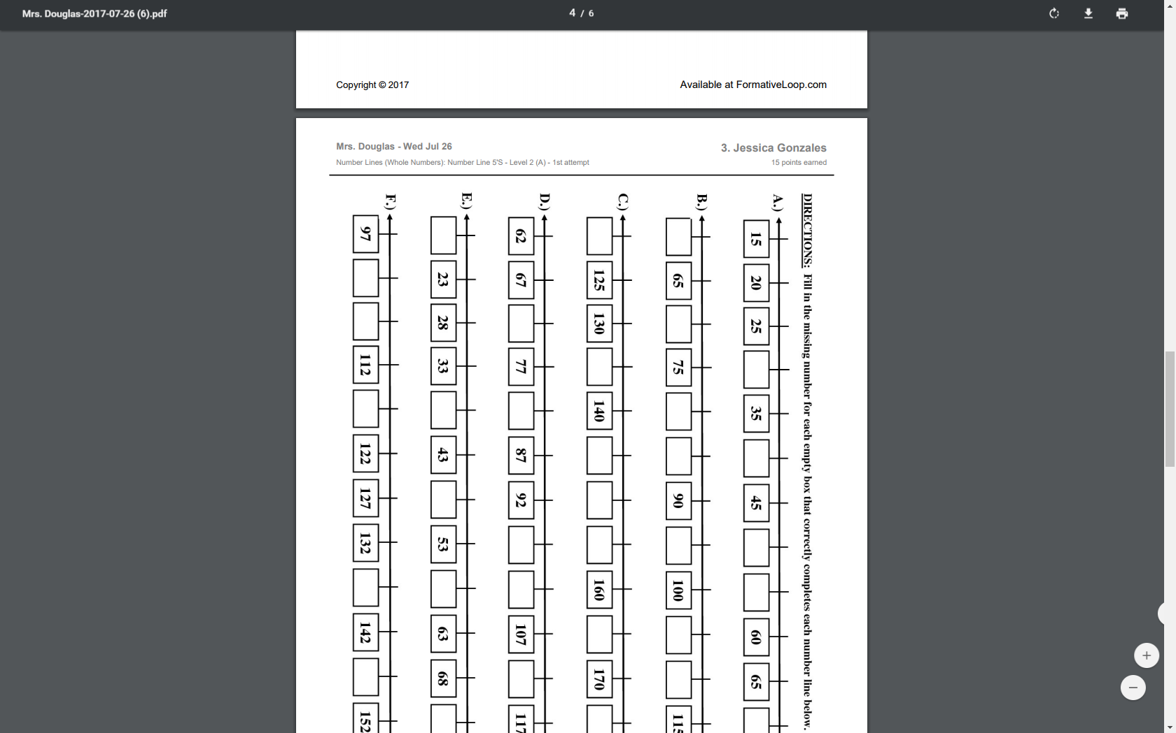

Slide 21
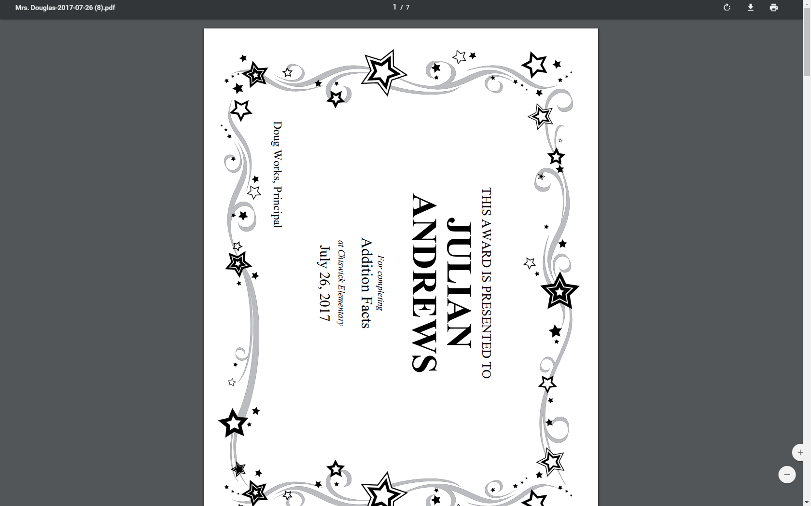
Award certificates print out when students finish major units

Slide 22
Printing Tips
Always use your network copy machine for printing
Possible to combine with a weekly spelling list or other activity on the back
Use colored paper for fun on holidays!

Slide 23
Formative Loop Points
Points are awarded for progress throughout the program
Daily attempt (Retry) – 5 points
Passing a skill – 10 points
Passing a mixed assessment – 20 points
Recommended levels for real-world incentives
100 points – large reward (trip to the treasure box, lunch with the teacher, Hershey kiss from the principal)
50 points – medium reward (line leader, shoes off day, bring a toy from home)
25 points – small reward (get a sticker, choose the story to be read, choose your seat)
Optional template for printing paper “points currency” : http://formativeloop.com/wp-content/uploads/Loopers.pdf

Slide 24
Who manages the program
Classroom teacher
Gives teacher clear insight into the progress their students are making
Teacher can control the pace based on individual student needs
Takes ~4-7 minutes
Administered by a math coach or other staff
Papers picked up and graded each day outside classroom by staff
Some schools have the entire population start after morning assembly
Best for consistency across campus
No impact on classroom teacher
Notes:
This is an optional slide to describe the two approaches for running the program.

Slide 25
Your First Day

Slide 26
Login to formativeloop.com with you school email
Find your class in the list

Slide 27
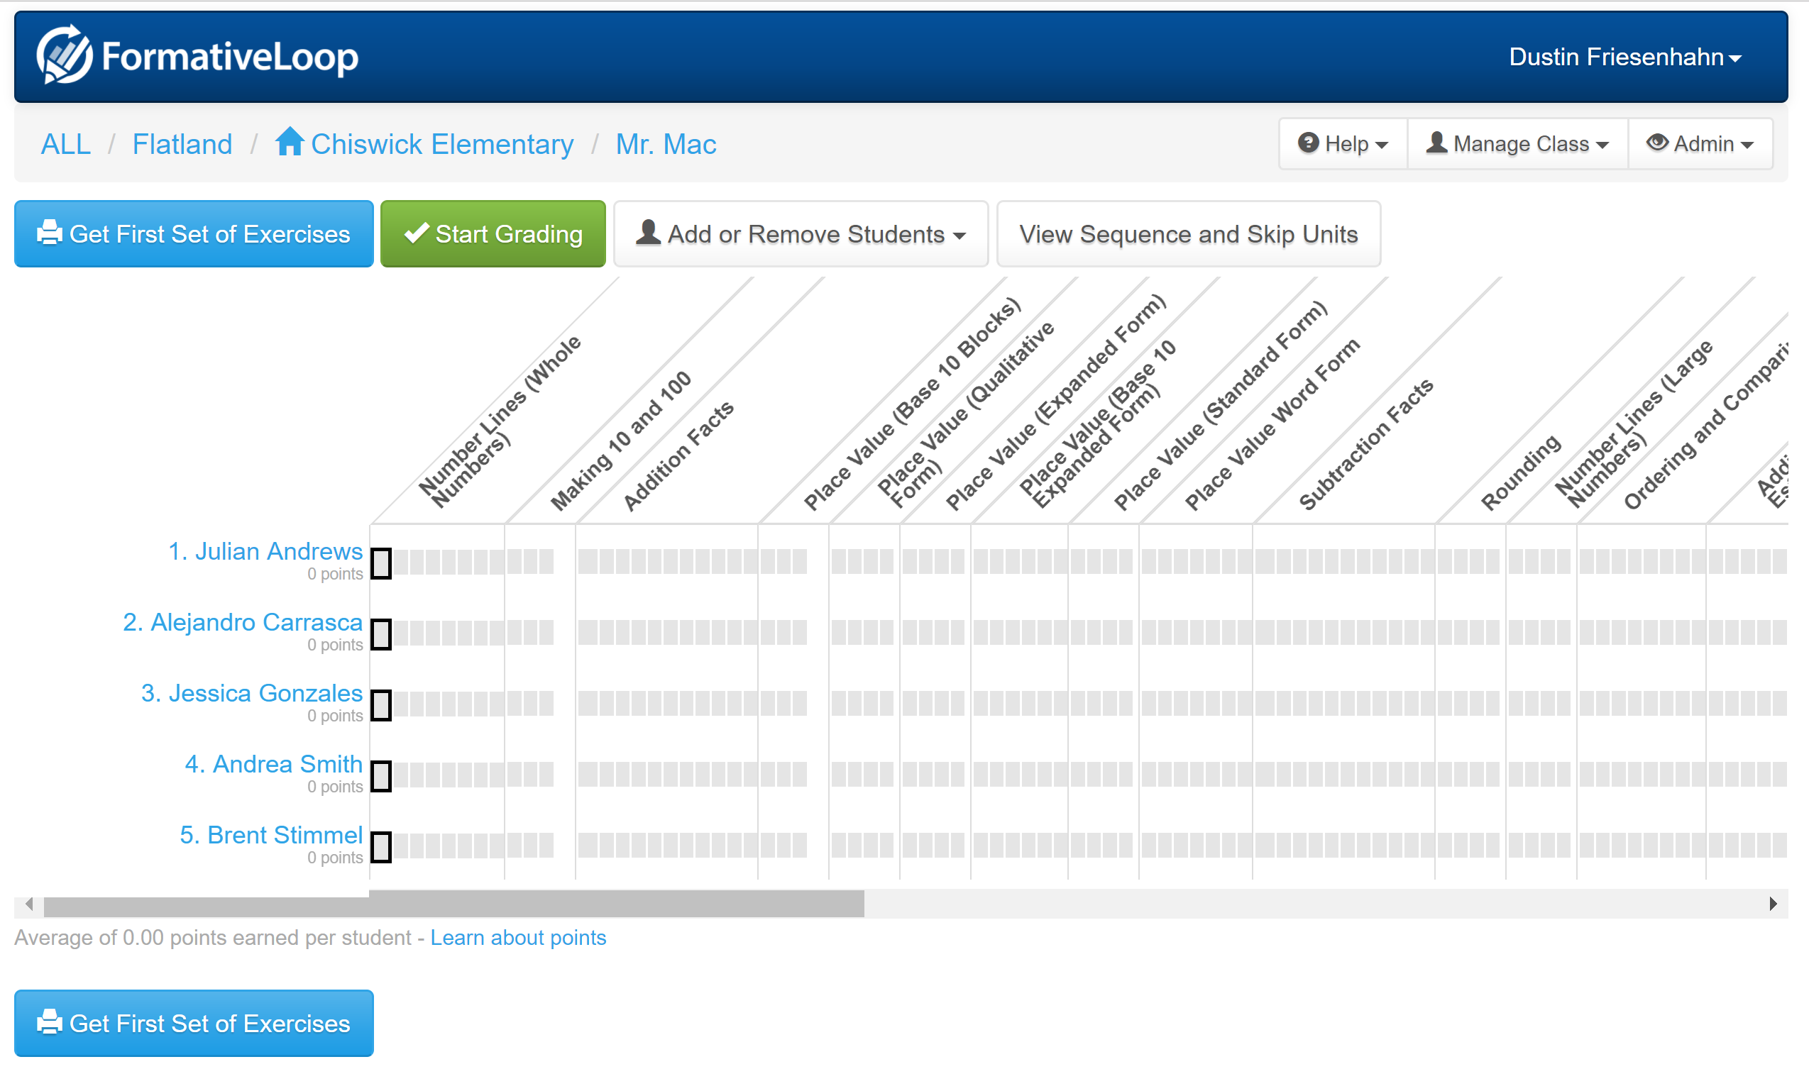
This screen shows each student’s progress

Slide 28
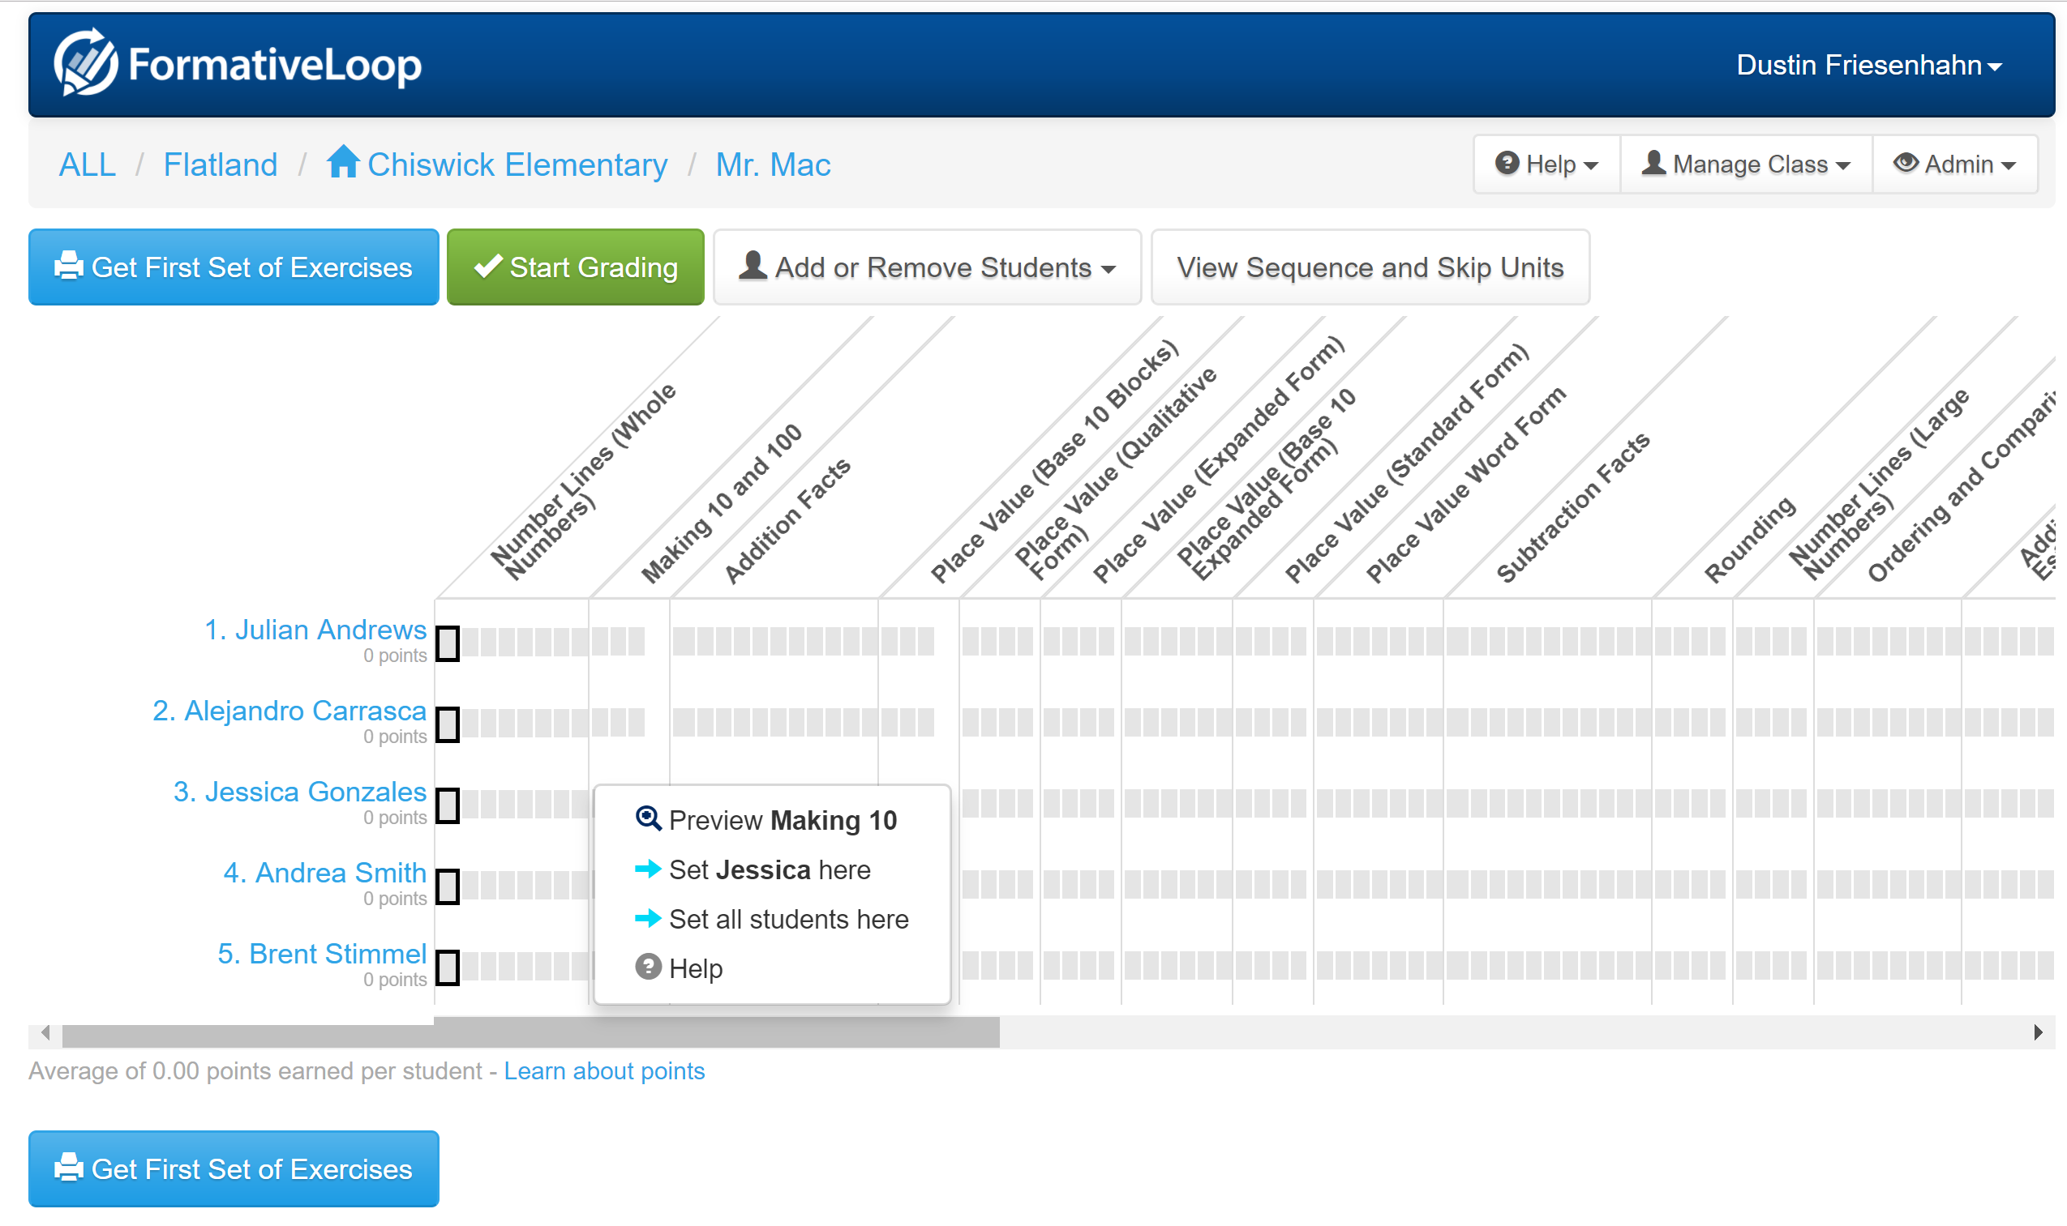
Click on a skill if you want to SKIP a student ahead (usually just start everyone at the beginning)

Slide 29
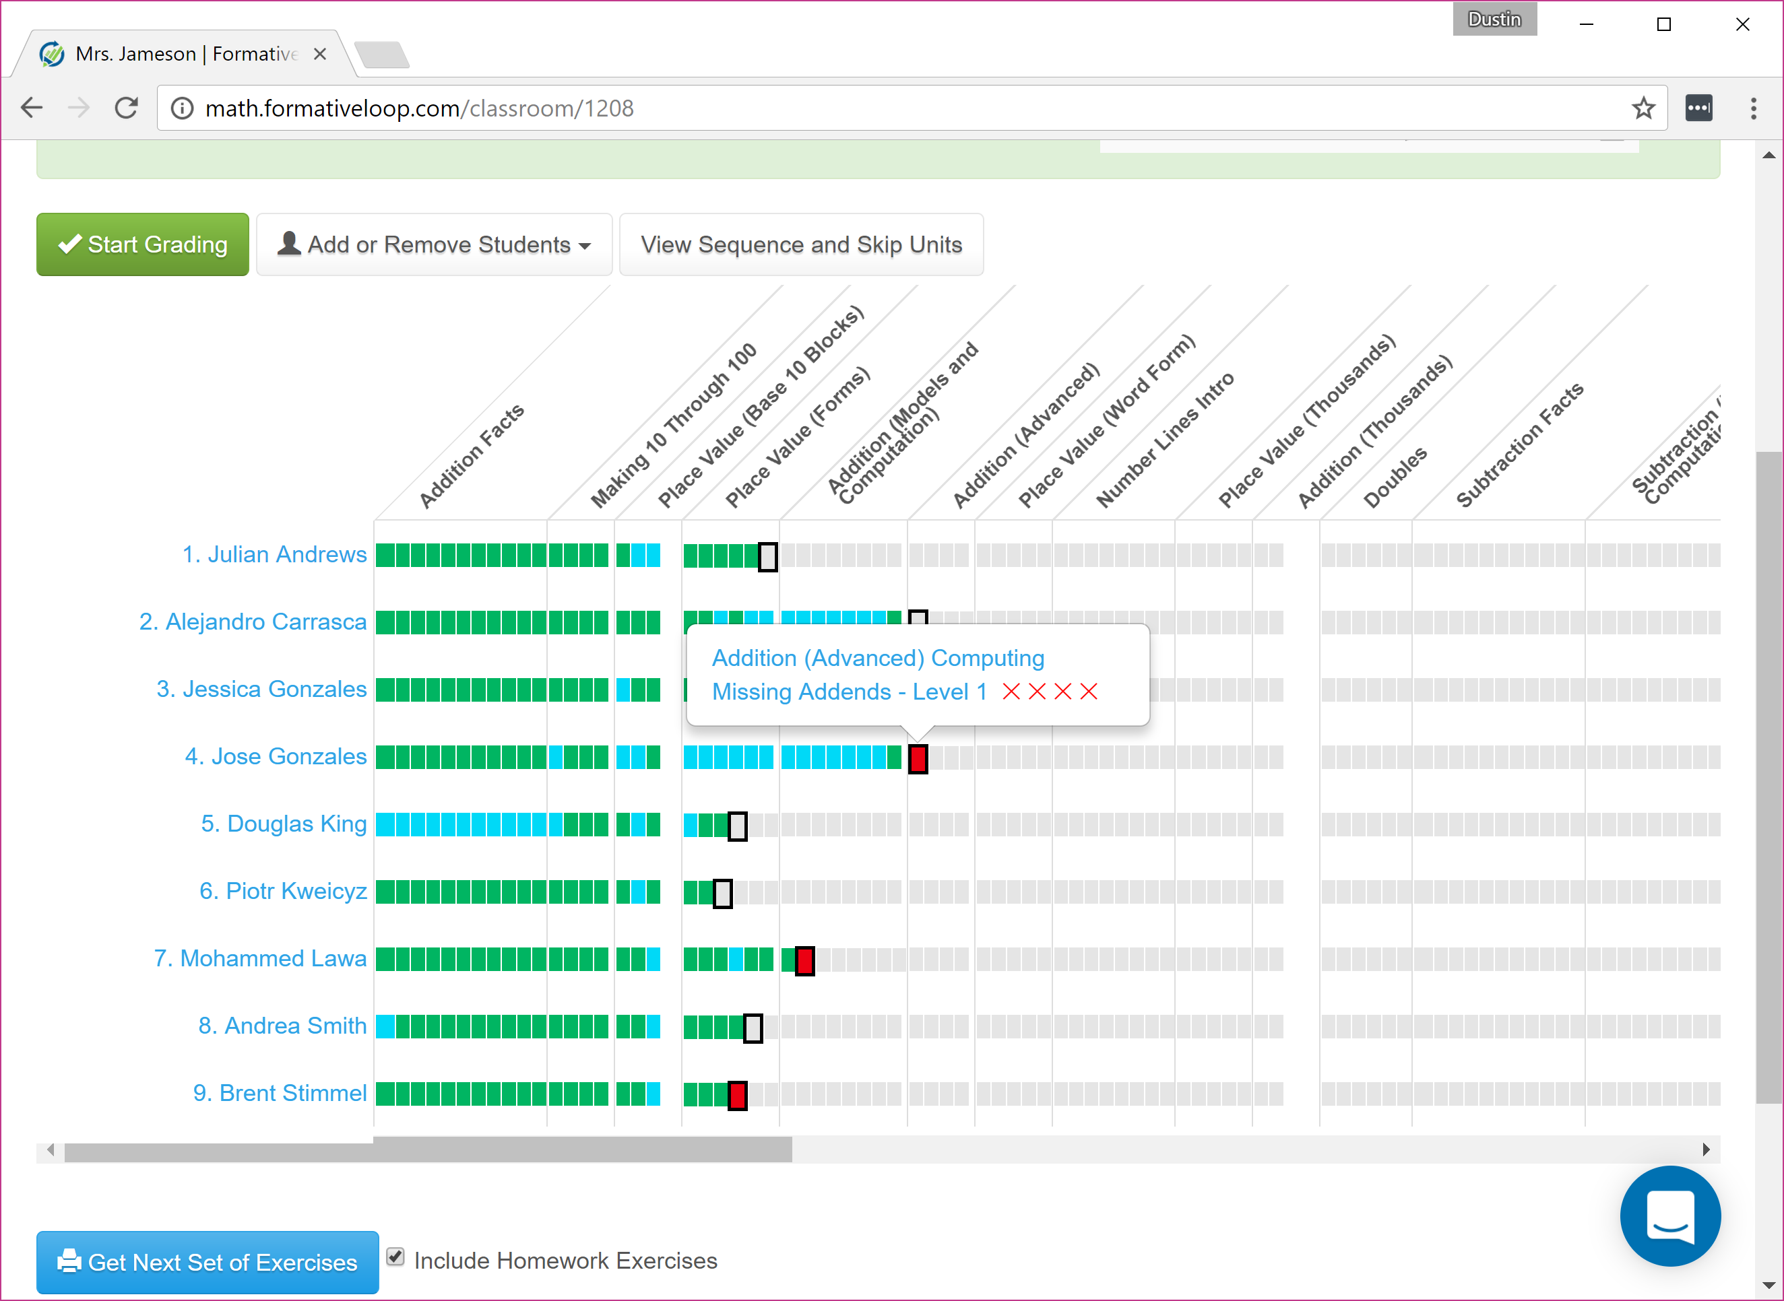
Later you will be able to hover over a skill to see how many attempts -> light blue are skills that were skipped

Slide 30
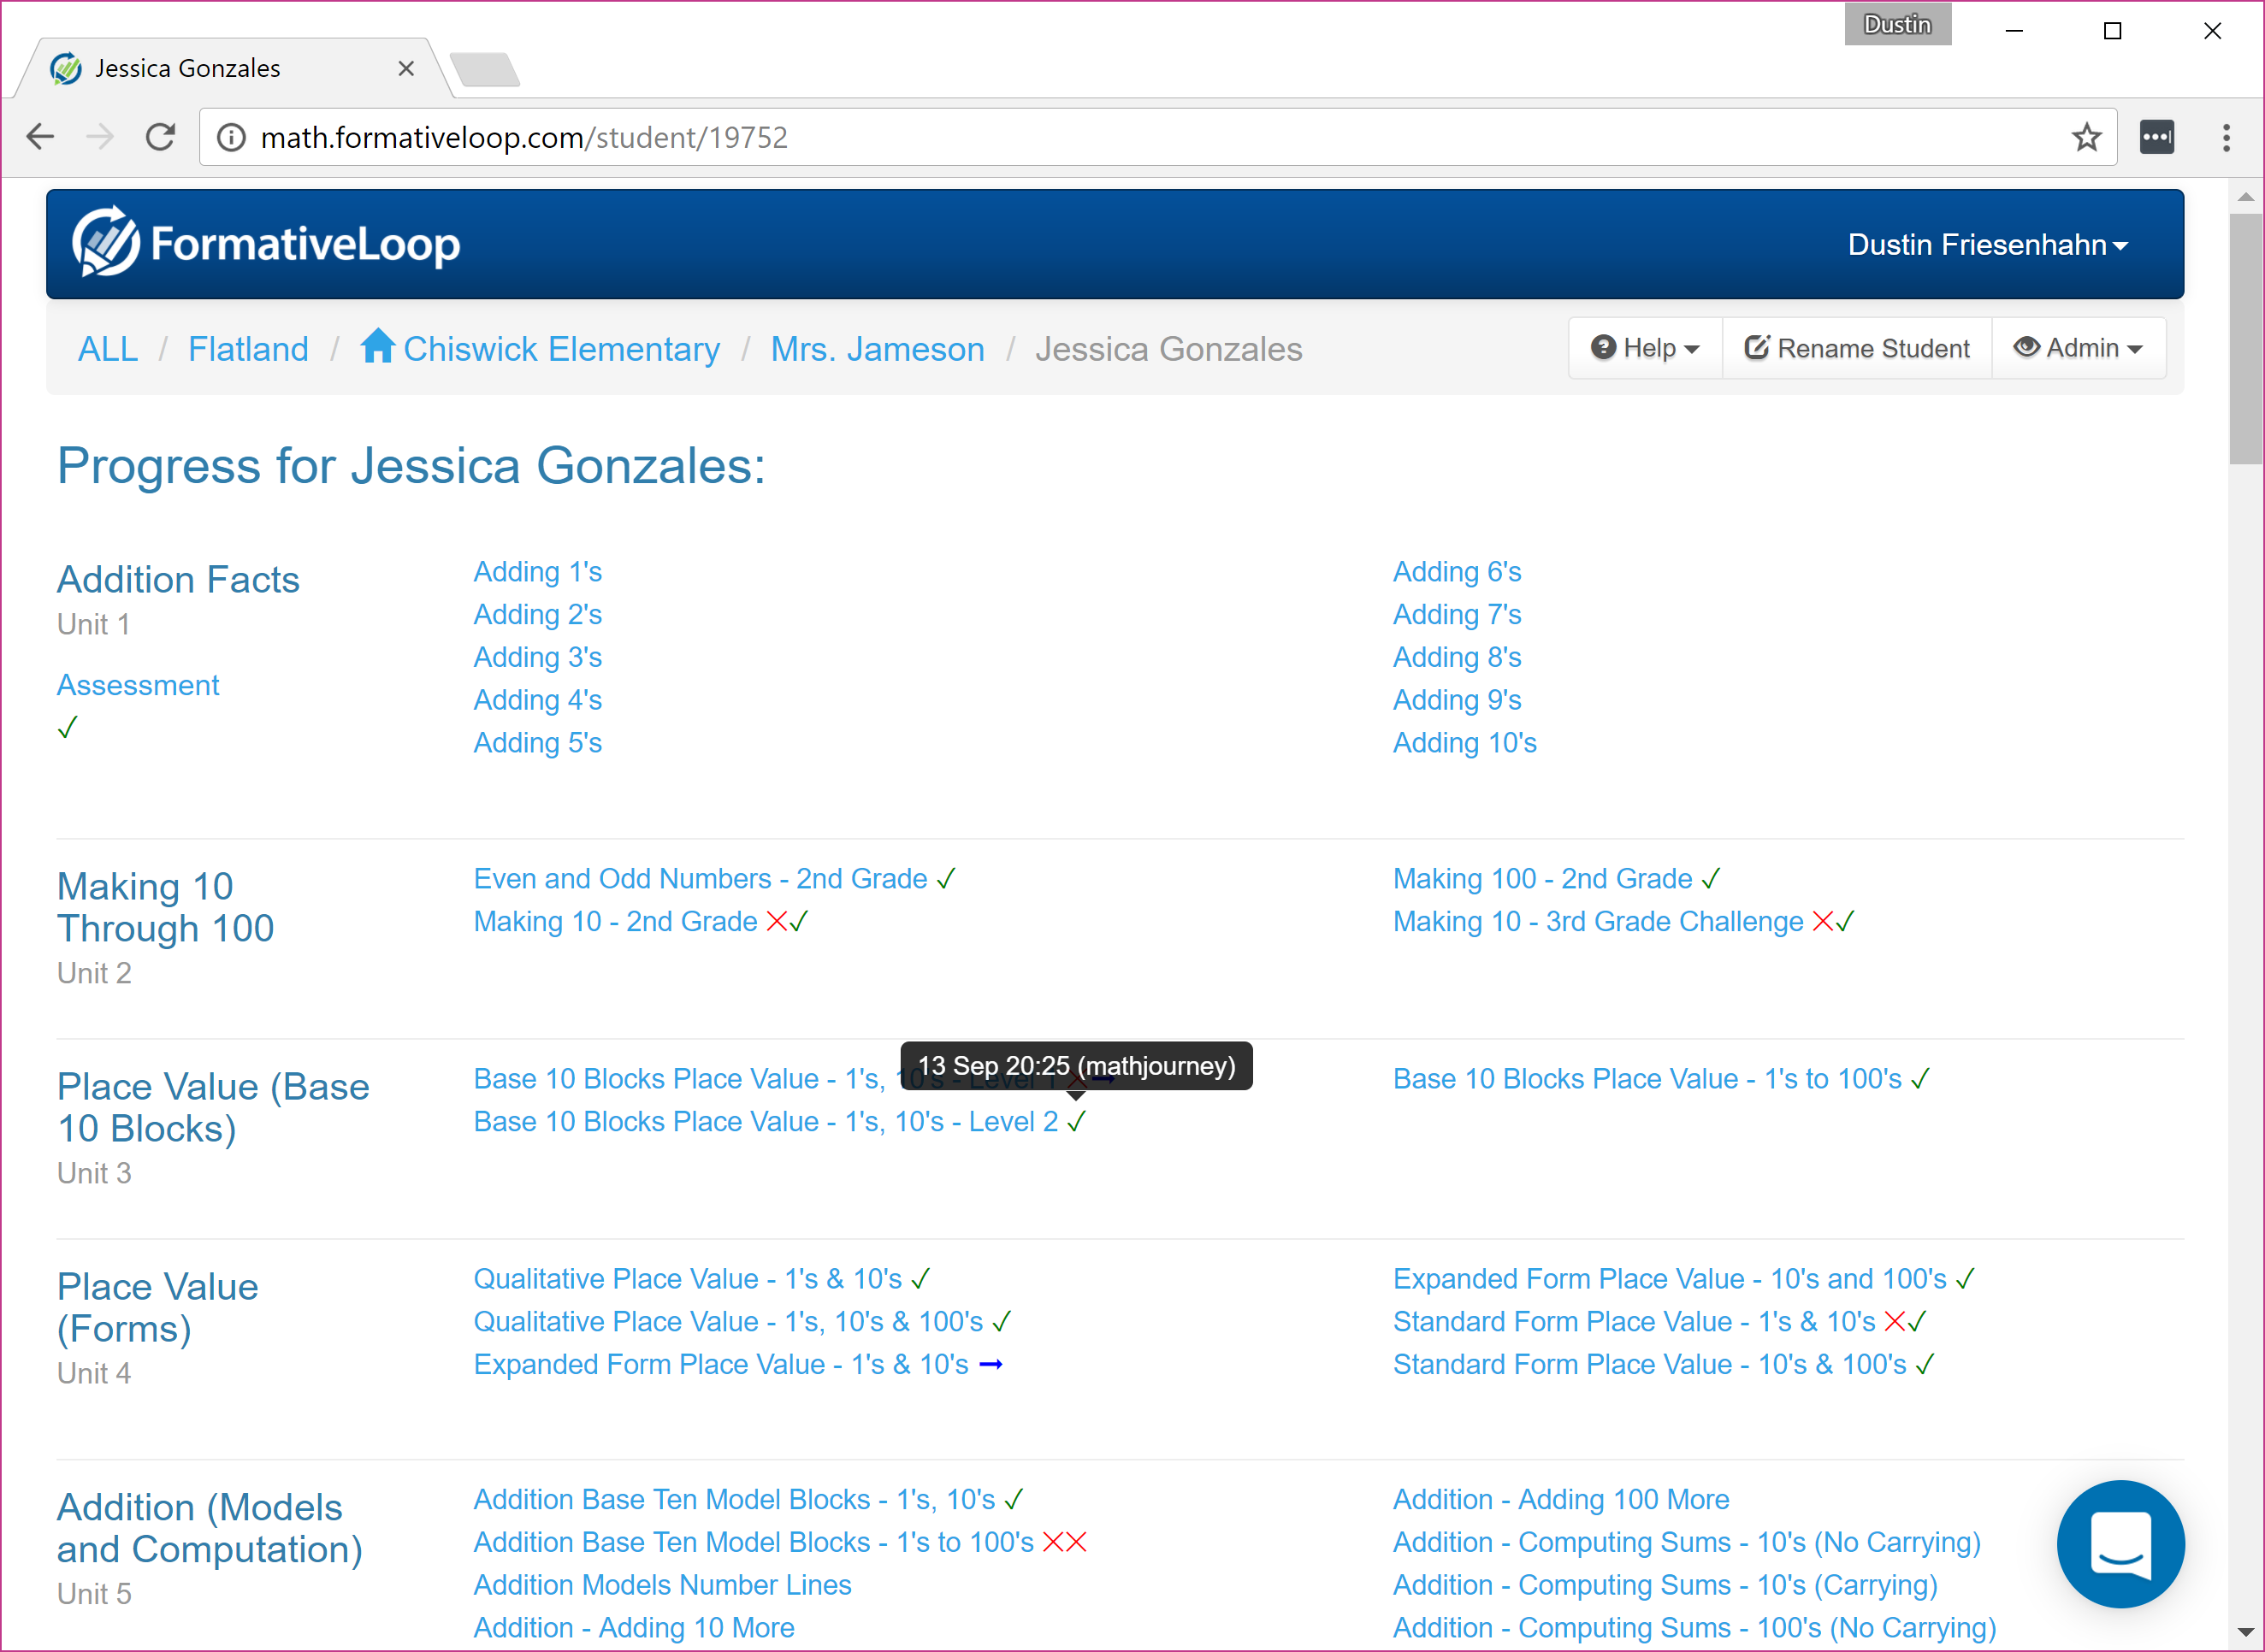
Clicking on a student presents their progress in the program

Slide 31
Just click “Get First set of Exercises” and print to get started!

Slide 32
Review of key best practices
Commitment to practice - Getting to 4 or 5 days a week will greatly improve your success
Spot check! Grading for accuracy takes too long – it’s a daily practice, and needs to be efficient in order for your to be able to manage it!
Intervention for stuck students – When a student retires more than 3 times, the program will highlight them as stuck. Make sure to provide extra assistance to help them with that skill.
Build an easy incentive program with the points – When done well, the students will beg you to do math!

Slide 33
Thank You!
For help, reach out to
your campus coordinator or
support@formativeloop.com

